Slide 1
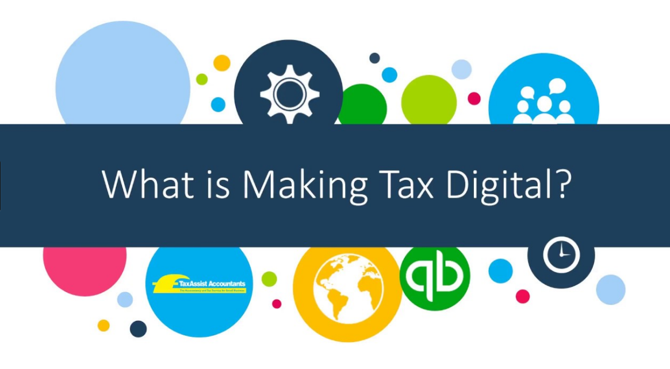
MTD Guide 2017
LeeP Financial Accountants

Slide 2
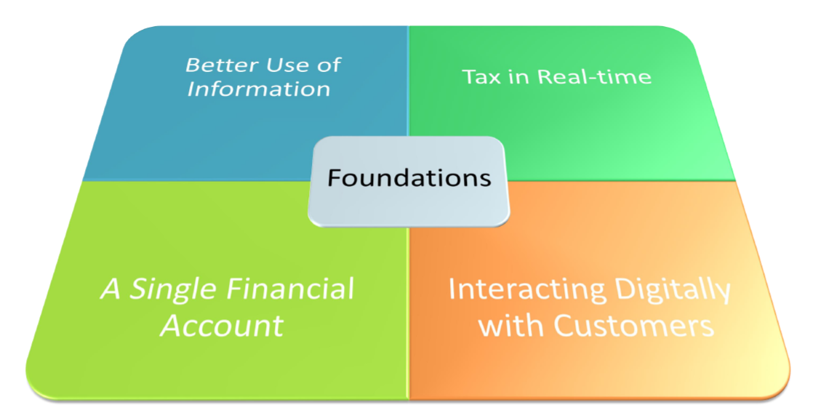
Objectives of Making Tax Digital
- Applies to Individuals & Businesses

Slide 3
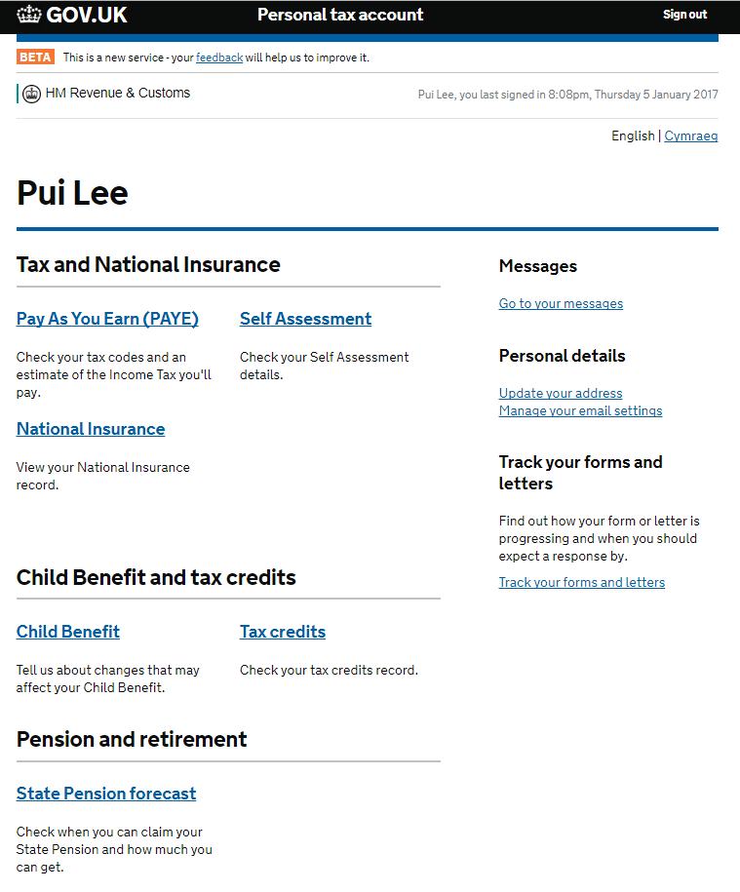
What Does It Mean For Me?
Fewer Tax Returns – Millions of taxpayers no longer need to tell HMRC information it already knows e.g. Salary details under PAYE
The tax system will operate in ‘real time’ keeping everyone up to date with their tax position
All Individuals/ Landlords & Businesses will have digital tax account
Self Servicing
See your Tax Code
Check your Pension & NI record
Manage Tax Credits, Child Benefits & other Benefits
File your Self Assessment Tax Return
Annual Tax Summary – Budgeting
Communicate with HMRC

Slide 4
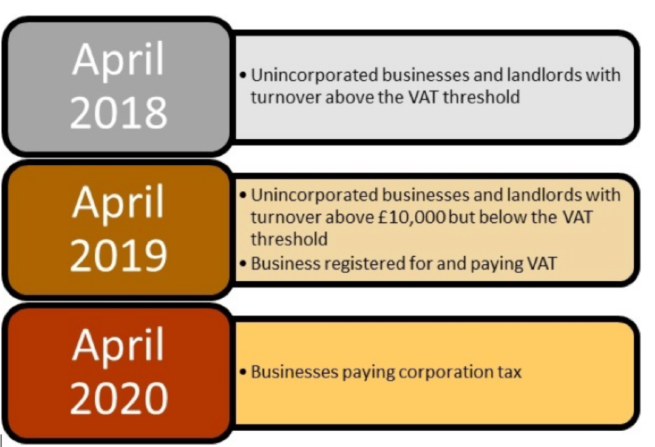
What, When & Who?
What
Keep Records Digitally – Spreadsheets OK
Quarterly submission of Accounting Information – must use Commercial Software that can “talk” to HMRC systems
When
New timetable in the Finance Bill 2017 amendment on 13th July 2017
Simplified
Delayed until April 2019
Who
Businesses with Turnover > £85,000

Slide 5
The Latest MTD Timetable
April 2019
Businesses & Landlords with a turnover above the VAT threshold (currently £85,000)
April 2020
All Other Businesses and Landlords
Exemptions
Individuals who can not go digital – elderly, location, disability, religion
Turnover < £10,000
Charities

Slide 6
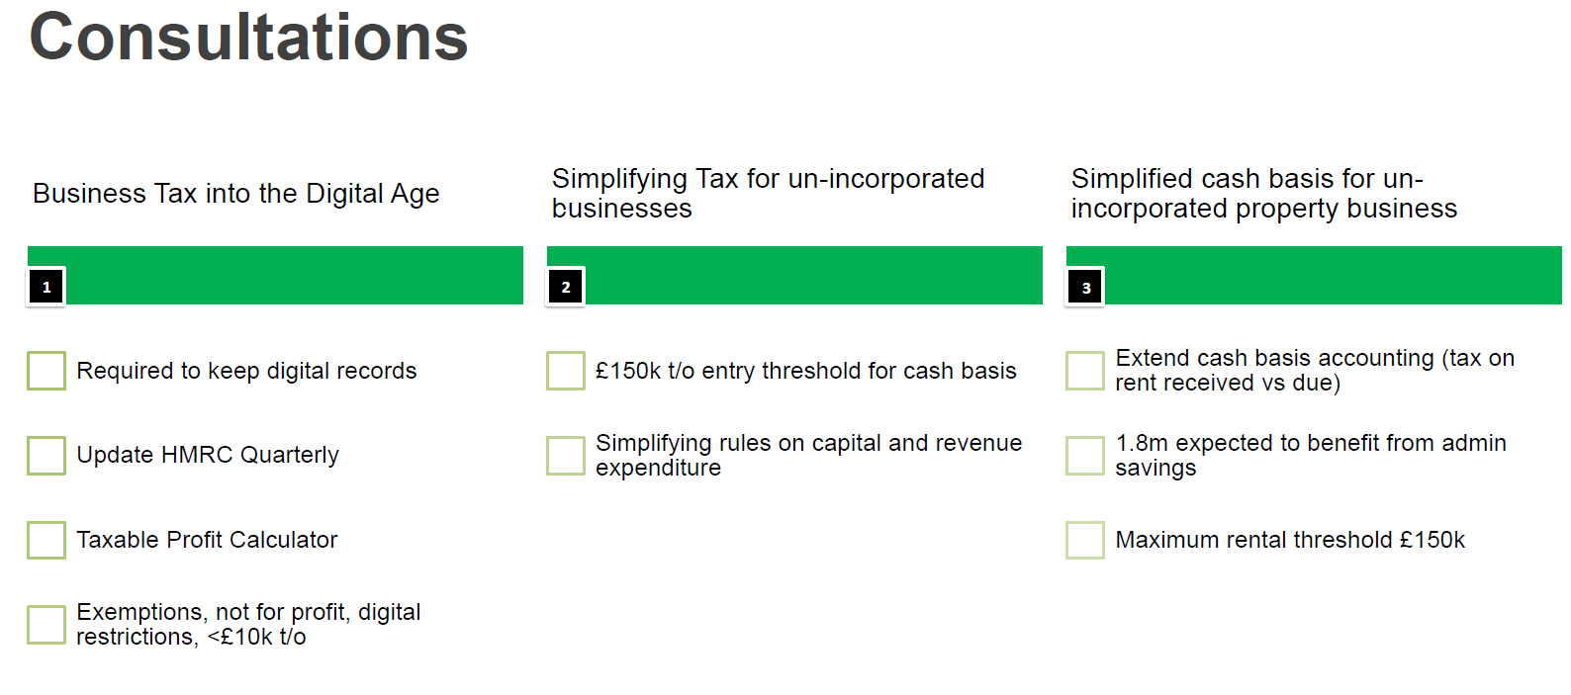

Slide 7
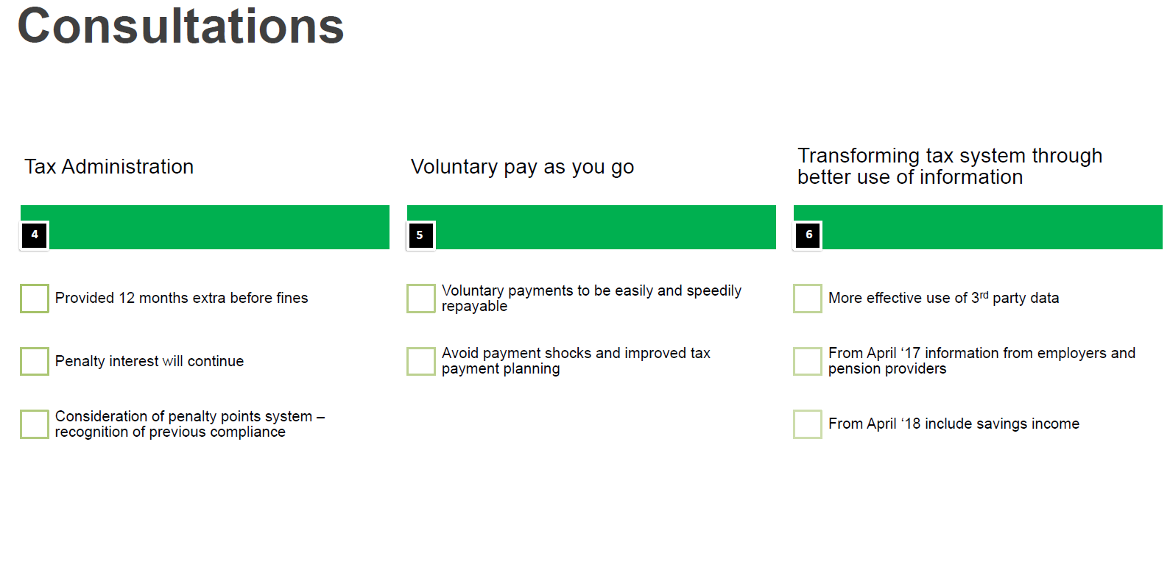

Slide 8
What type of Business are YOU?
Successfully using Accounting Software
Keeping Manual Records
Using Spreadsheets
Accountant e.g LeeP
HMRC

